Slide 1
Dynatrace 自主云管理工作坊
Aliyun、Jenkins、Ansible Tower
Notes:
Dynatrace Autonomous Cloud Management
GKE, Jenkins, Ansible Tower

Slide 2
主要蓝图 - 牢不可破的持续交付模式
自我 修复
自动化操作（自我修复） – 在生产中自动处理不良部署
Shift-right /
部署速度
自动部署（Shift-Right） – 推广"监控即代码", 实现自动验证和自动告警
Shift-left /
质量闸门
自动化质量（Shift-Left） – 发布管道自动化, 停止更改了的不良代码推送到生产品环境
多平台监控
自动化监控 – 战略性地使用监控作为端到端管道的功能
Notes:
Key blue print – unbreakable continuous delivery model
Automate operations (self-healing) – auto-mitigate bad deployments in production
Automate deployment (shift-right) – push “monitoring-as-code” for auto-validation and auto-alerting
Automate quality (shift-left) – automate the pipeline and stop bad code changes before they reach prod
Automate monitoring – use monitoring strategically as feature of the end-to-end pipeline

Slide 3
我们将完成什么
部署”袜子店”应用于我们的 Kubernetes（Aliyun）集群
在（Aliyun 的）Kubernetes 上设置 Jenkins
导入 Jenkins 管道
与 Jenkins 建立动态集成
使用 Jenkins 插件和 Monospec
部署不同的代码 Build 并测试其性能
如果代码（基于 Monospec）不能达标, 部署便会失败
使用 Dynatrace 和 Ansible Tower 创建自愈应用
Notes:
What we will accomplish
Deploying the SockShop application to our GKE cluster
Setting up Jenkins on K8s in GKE
Import a Jenkins Pipeline
Setup Dynatrace Integration with Jenkins
Using Jenkins Plugin and Monspec
Deploy different code builds and test their performance
Fail pipeline if code is not performant based on monspec
Create a self-healing application using Dynatrace and Ansible Tower

Slide 4


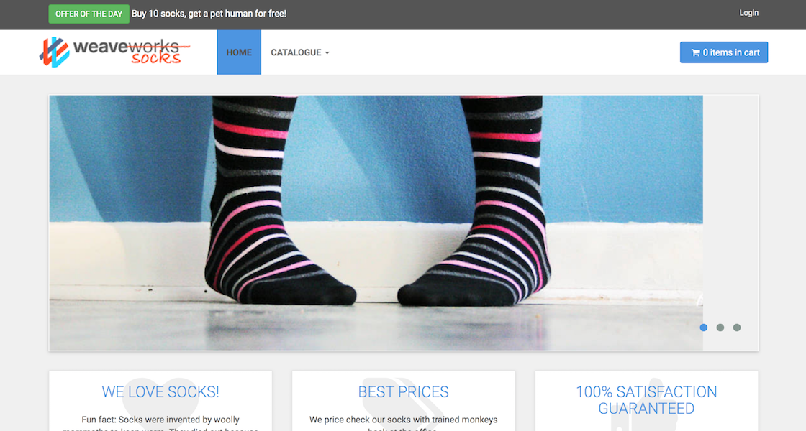


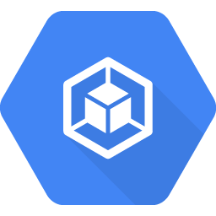







Workshop setup
示例应用
GitHub 存储库
#2下载回购
#1创建 Dynatrace 租户
#3部署Jenkins
#4部署Ansible Tower
每个团队在笔记本 电脑上（或通过 CloudShell）
Kubernetes
Jenkins
Aliyun ACK实例
Ansible Tower
Notes:
Workshop Setup

Slide 5
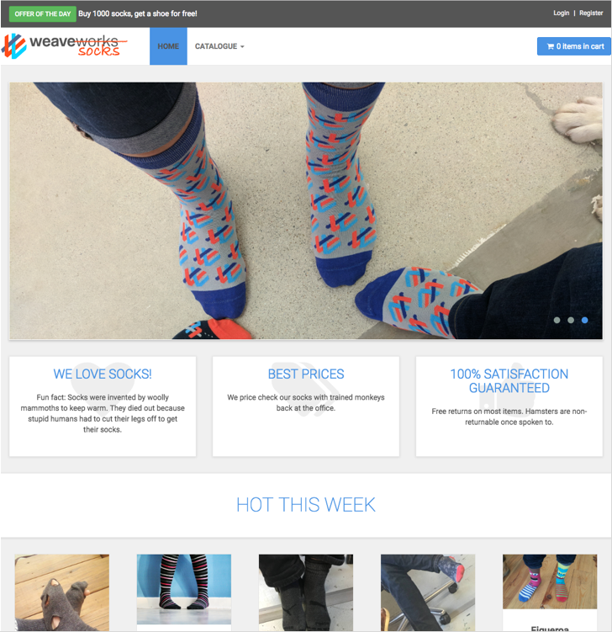
袜子店应用
基于：http://socks.weave.works
开源微服务示例应用
多语种
Java Spring Boot
Go
Node.js
Rabbit MQ（订单队列）
MongoDB、MySQL（数据存储）
Notes:
Sock Shop Application
Based on: http://socks.weave.works
Opensource microservice sample app
Polyglot
Java Spring Boot
Go
Node.js
RabbitMQ (order queuing)
MongoDB, MySQL (data stores)

Slide 6
袜子店架构
Notes:
Sock Shop architecture

Slide 7
Jenkins
世界上最先进的 BASH 终端
在大多数情况下, 可以通过简单的 kubctrl 命令部署到 Kubernetes
大多数部署可能以这种方式执行
阻碍性告警：我们今天要这么做
没有真正的"简单"方法来确定故障或应用是否启动并运行
$kubectl wait –n dev deploy/myapp –-for condition=available
这不会捕获实际上未上线的 Pod
Notes:
Jenkins
The Worlds most advanced BASH terminal
In most cases it’s fine to deploy to K8s via simple kubectl commands in k8s
Most of deployments probably done this way
Spoiler Alert: We’re going to be doing this today
No true “easy” way to determine a failure or if app is up and running
$kubectl wait –n dev deploy/myapp –-for condition=available
This won’t catch pods that didn’t actually come online

Slide 8
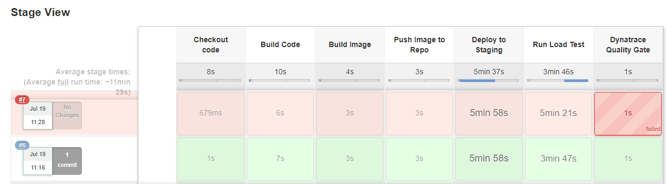
我们的管道会是什么样子（希望）
Notes:
What our Pipeline will look like (hopefully)

Slide 9
让我们开始旅程
Notes:
Let’s Start the fun

Slide 10
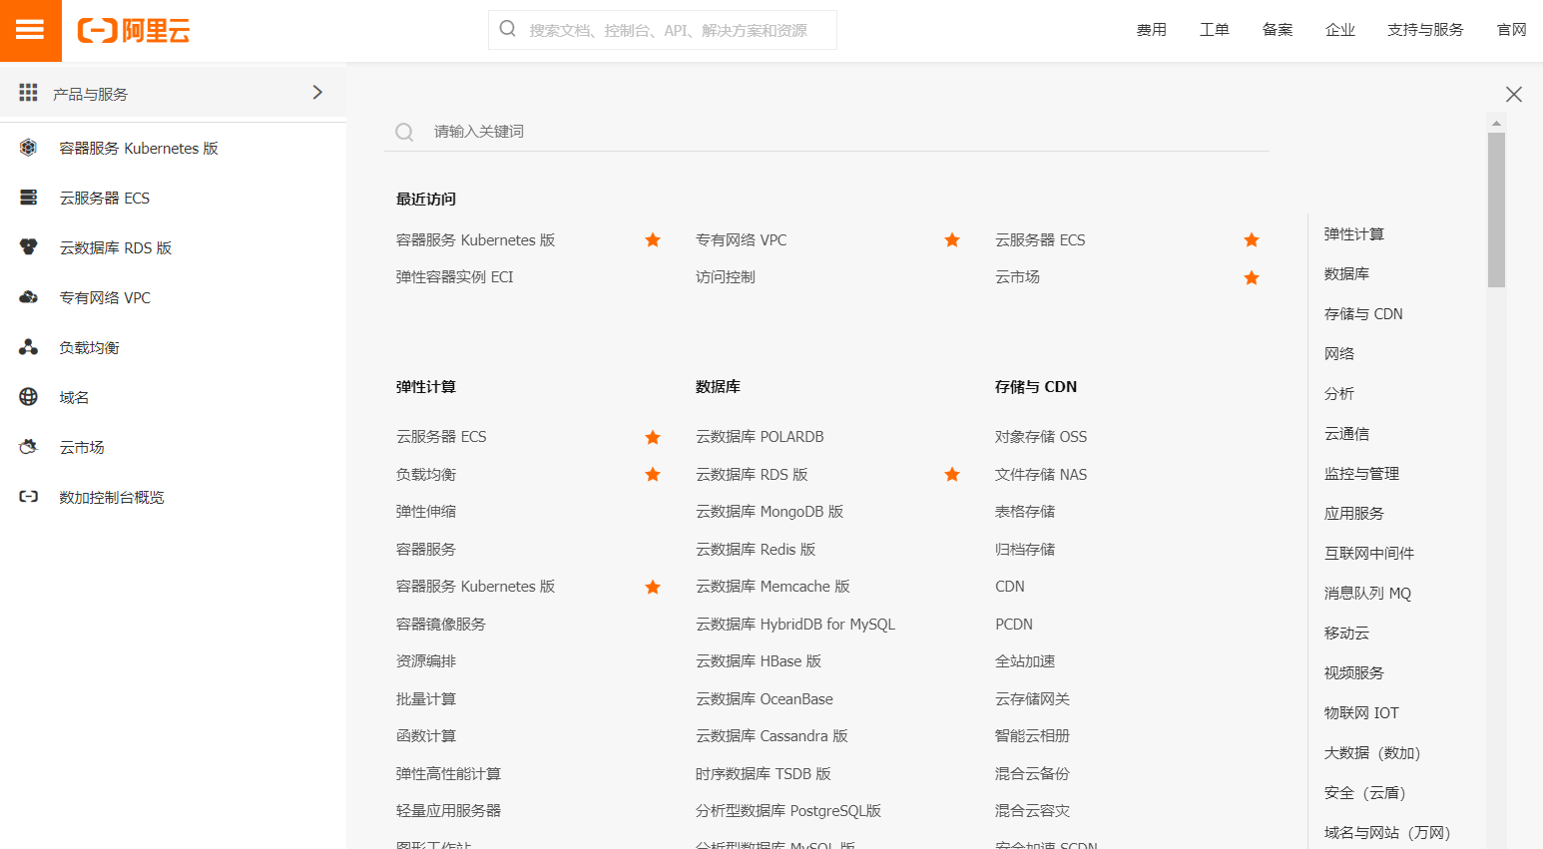
设置我们的 Aliyun k8s群集
登录到您的Aliyun账户
Notes:
Setup our GKE Cluster
Login to your GCP Account

Slide 11
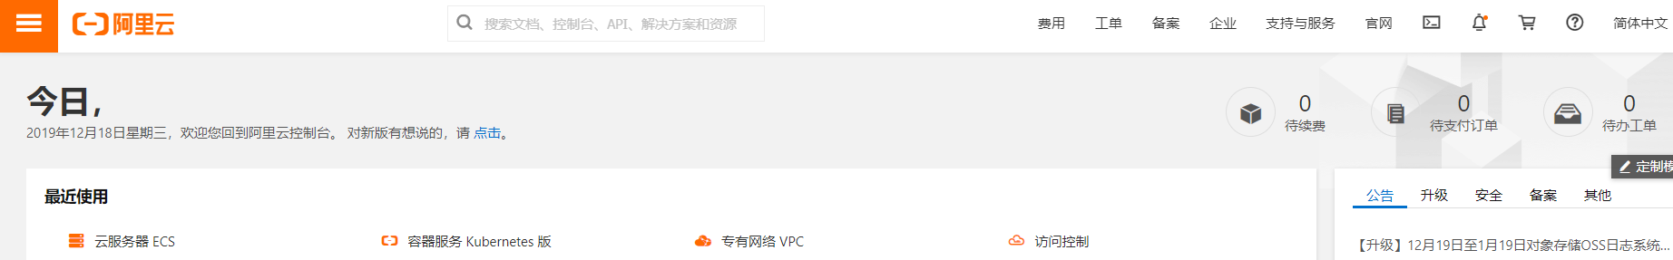
设置我们的 Aliyun k8s群集 + 启动 CloudShell
我们使用aliyun CloudShell
CloudShell 直接从浏览器对云资源进行命令行访问
无需单独的堡垒主机
预安装所需的工具（git、docker、kubectl等）
持久存储
Notes:
Setup our GKE Cluster – Launching Cloudshell
To launch and interact with our Kubernetes cluster we use Cloudshell
Cloudshell provides command-line access to your cloud resources directly from your browser
No need for a separate bastion host
Required tools pre-installed (git, docker, kubectl, etc…)
Persistent storage

Slide 12
设置我们的 Aliyun k8s群集 – 克隆我们的存储库
在CloudShell, 克隆/下载以下 GitHub 存储库： https://github.com/ideovo/dtacmworkshop
这将创建一个名为 dtacmworkshop 目录
这将包含我们将在工作坊的其余部分使用的脚本
Notes:
Setup our GKE Cluster – Cloning our repository
In Cloudshell, clone/download the following GitHub Repository:
https://github.com/dynatrace-acm/dtacmworkshop
This will create a folder called dtacmworkshop
This will contain the scripts we will use for the remainder of the workshop

Slide 13
Dynatrace 凭据 + 租户 ID + 环境 ID
为了进一步进行, 我们需要记下我们的 Dynatrace 租户/环境和 API/PaaS 令牌
对于租户 ID, 您可以在 URL 的第一部分找到它
https://<TENANT_ID>.live.dynatrace.com = SaaS 部署
例如, 对于https://jwx05250.live.dynatrace.com, 租户 ID_jwx05250
https://<TENANT_ID>.dynatrace-managed.com
例如, 对于https://abc123.Dynatrace-managed.com, 租户 ID_abc123
环境 ID 仅适用于 Dynatrace 托管部署。 您可以在 URL 的后半部分找到此值
https://<TENANT_ID>.dynatrace-managed.com/e/<ENVIRONMENT_ID>
例如, 对于https://abc1234.Dynatrace-managed.com/e/1234-5678, 环境 ID=1234-5678
Notes:
Dynatrace Credentials – Tenant ID & Environment ID
In order to proceed further we need to make note of our Dynatrace Tenant/Environment and API/PaaS Tokens
For the Tenant ID, you can find it in the first part of your URL
https://<TENANT_ID>.live.dynatrace.com – SaaS Deployments
For example, for https://jwx05250.live.dynatrace.com , Tenant ID=jwx05250
https://<TENANT_ID>.dynatrace-managed.com
For example, for https://abc123.Dynatrace-managed.com, Tenant ID=abc123
The Environment ID is only applicable for Dynatrace Managed Deployments. You can find this value in the second half of your URL
https://<TENANT_ID>.dynatrace-managed.com/e/<ENVIRONMENT_ID>
For example, for https://abc1234.Dynatrace-managed.com/e/1234-5678, Environment ID=1234-5678

Slide 14
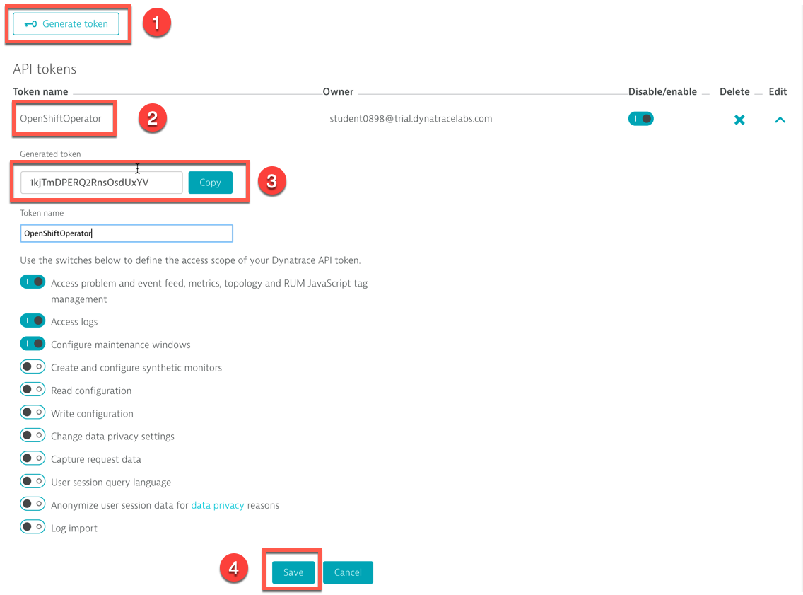
Dynatrace 凭据 = API 令牌
进入 Settings → Integration → Dynatrace API
单击生成令牌
输入令牌的名称（例如 GKE）
不要忘记单击 “Save“ 按钮
Notes:
Dynatrace Credentials – API Token
Go in Settings -> Integration -> Dynatrace API
Click on Generate Token
Enter a name for your token (e.g. GKE)
Don't forget to click on the Save button

Slide 15
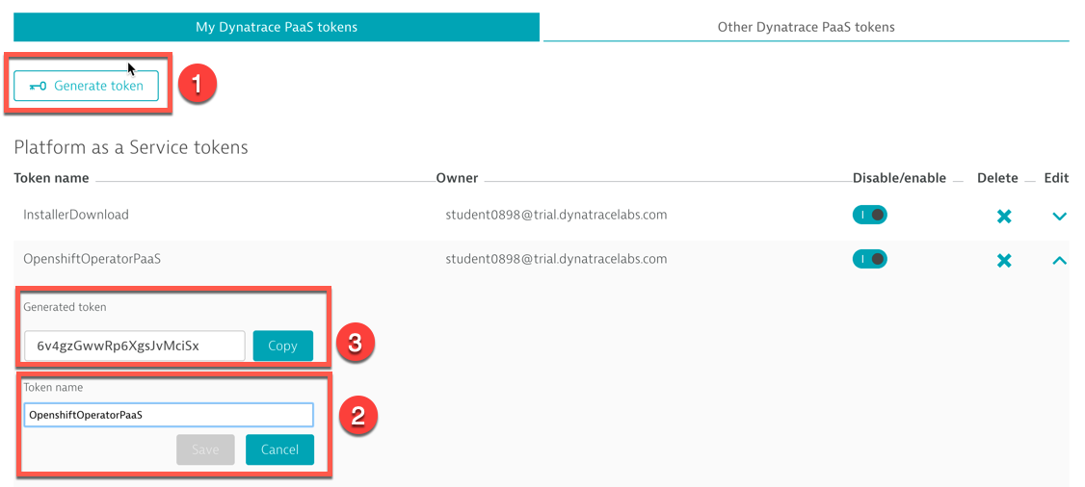
Dynatrace 凭据 = PaaS 令牌
进入 Settings → Integration → Platform as a Service
复制现有安装程序下载令牌或单击生成令牌
输入令牌的名称（例如 GKE）, 单击 “Save"
Notes:
Dynatrace Credentials – PaaS Token
Go in Settings -> Integration -> Platform as a Service
Either copy the existing InstallerDownload token or click on Generate Token
Enter a name for your token (e.g. GKE), click Save

Slide 16
创建我们的凭据
现在, 我们需要存储 Dynatrace 租户和 API 信息的本地副本, 以便在创建集群时使用
导航到目录 1-Credentials 并执行脚本 defineCredentials.sh
这将要求您提供 Dynatrace 租户/环境信息以及 API 和 PaaS 令牌
这些值可以从 Dynatrace 租户处获取（请参阅前面的投影片）
输入值并确认它们正确后, 我们可以继续创建群集
Notes:
Creating our Credentials
We now need to store a local copy of our Dynatrace Tenant and API info for use when creating our cluster
Navigate to the directory 1-Credentials and execute the script defineCredentials.sh
This will ask for your Dynatrace Tenant/Environment information as well as your API and PaaS tokens
These values can be obtained from your Dynatrace tenant (see previous slides)
Once you have entered the values and confirmed they are correct, we can move on to creating our cluster

Slide 17
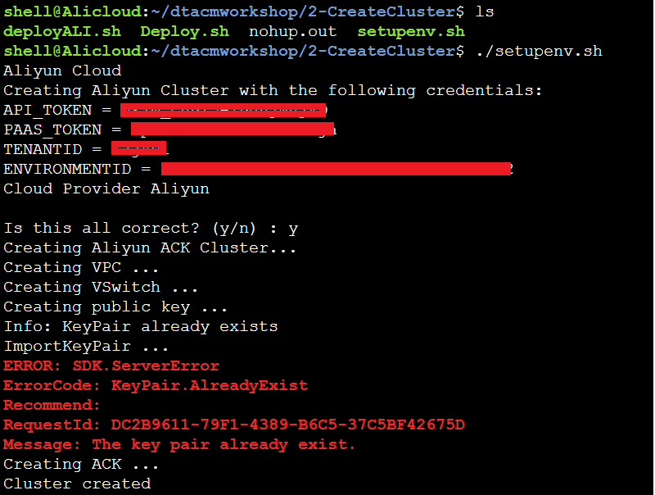
设置我们的 Aliyun k8s群集
回到您的 ali 帐户中, 启动 CloudShell 会话
导航到目录 2-CreateCluster
执行脚本 setupenv.sh 并确认您的凭据正确(创建cluster需要大概10分钟)
Cluster创建后(setupenv.sh脚本执行10分钟后)，执行脚本Deploy.sh，
Notes:
Setup our GKE Cluster
Back in your GCP account, launch a Cloudshell session
Navigate to the directory 2-CreateCluster
Execute the script setupenv.sh and confirm that your credentials are correct
This step will take about 10 minutes to complete

Slide 18
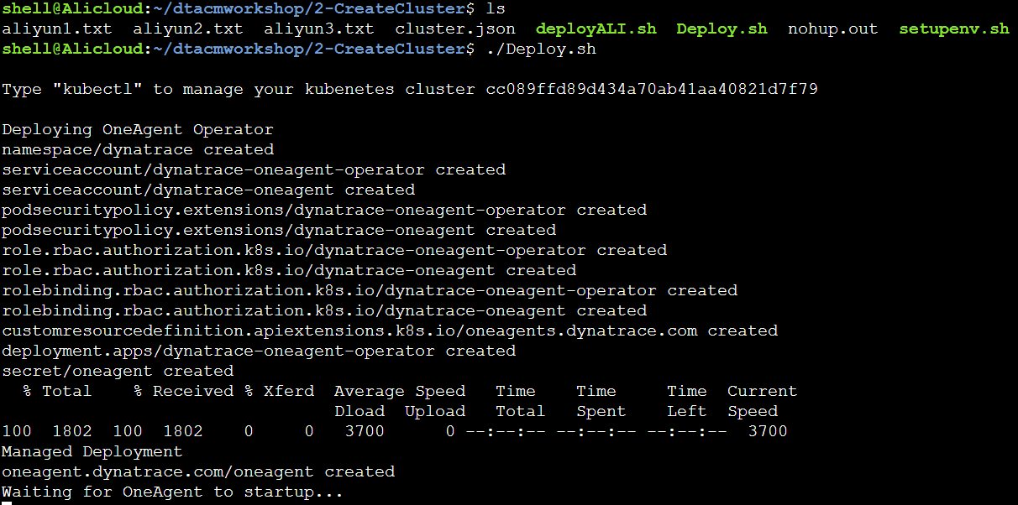
设置我们的 Aliyun k8s群集
setupenv.sh 脚本将执行以下操作：
#创建新的 Aliyun k8s群集
DeployApp.sh脚本将执行如下操作：
将 Dynatrace OneAgent 运算符部署到群集
部署袜子店应用到我们的群集
包括创建所需的namespace, PV, PVC,
LoadBalance
Notes:
Setup our GKE Cluster
The setupenv.sh script will do the following:
Create a new GKE cluster
Deploy the Dynatrace OneAgent Operator to the cluster
Deploy the SockShop application to our cluster
Including creating the required Namespaces, storage objects and LoadBalancers

Slide 19
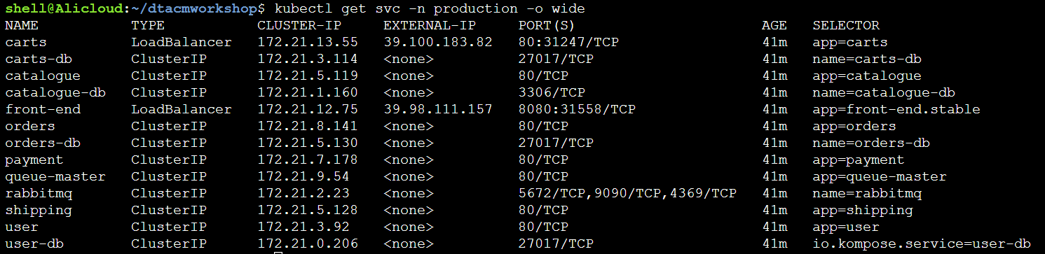
验证我们的群集设置
运行 DeployApp.sh 脚本大约 10 分钟后, 让我们验证一切是否启动并运行
让我们检查并确保我们的部署已准备就绪, 在 CloudShell:
kubectl get svc –n production -o wide
注意：还可以通过 Aliyun 控制台屏幕左侧的菜单中选择 “概况“ 进行验证
Notes:
Validate our Cluster setup
After about 10 minutes since running the setupenv.sh script, let’s verify that everything is up and running
Let’s check and make sure our Deployments are Ready, run the following command in Cloudshell:
kubectl get svc –n dev -o wide
Note: This can also be validated in the GKE Console by selecting “Workloads” from the menu on the left side of the screen

Slide 20
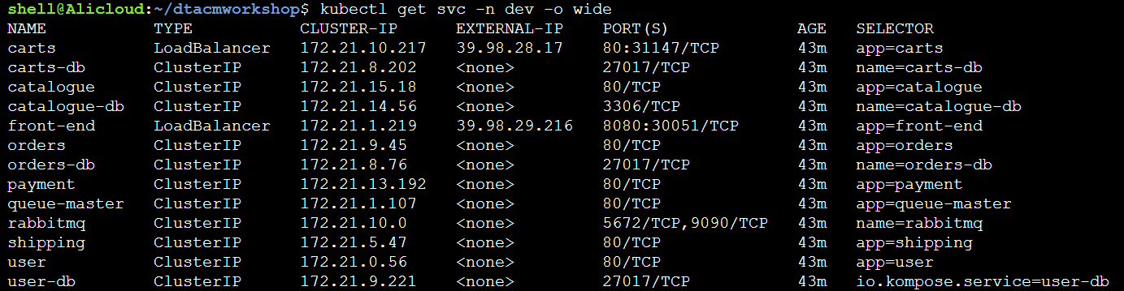
验证我们的群集设置
让我们确保袜子店应用服务也通过运行以下命令创建：
$kubectl get svc –n dev -o wide
我们的购物车和前端服务应分配外部 IP 地址
注意：还可以通过 aliyun 控制台屏幕左侧的菜单中选择 “概述“ 进行验证
Notes:
Validate our Cluster setup
Lets ensure that the SockShop application services are also created by running the following command:
$kubectl get svc –n dev -o wide
Our Carts and Front-end services should have External-IP addresses assigned
Note: This can also be validated in the GKE Console by selecting “Services & Ingress” from the menu on the left side of the screen

Slide 21
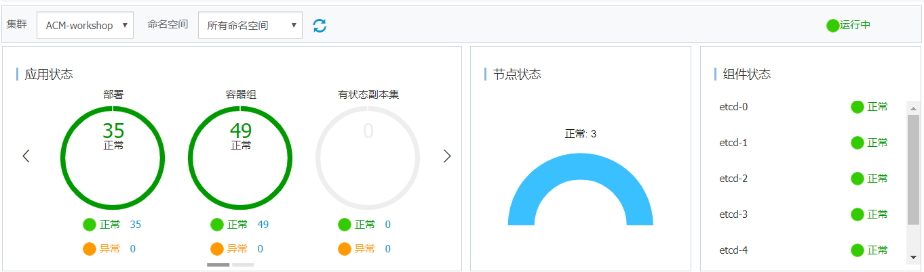
验证集群状态
在概述里，所有的应用状态都是正常的

Slide 22
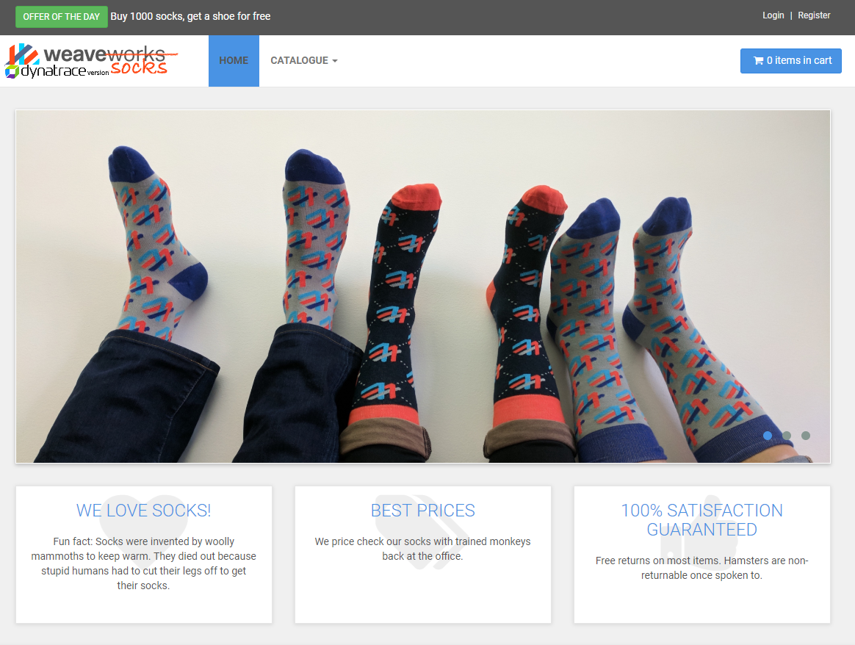
验证我们的群集设置
让我们通过复制和粘贴前端服务的外部 IP 和端口, 在 Web 浏览器中启动应用
在前面的示例中, 这会是：http://39.98.29.216:8080
袜子店主页应出现在您的浏览器
Notes:
Validate our Cluster setup
Let’s launch our application in a web browser by copying and pasting the External-IP and Port of the front-end service. In the previous example it would be: http://104.197.12.209:8080
The SockShop homepage should appear in
your browser

Slide 23
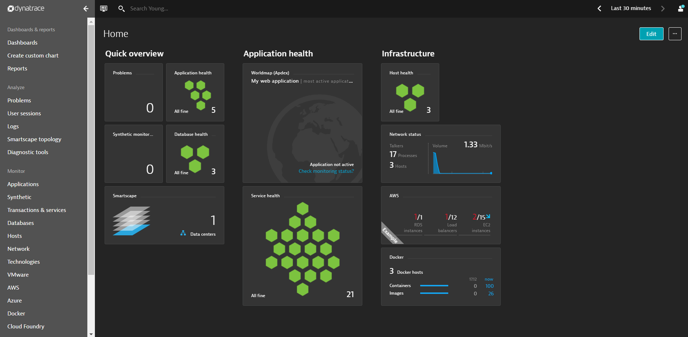
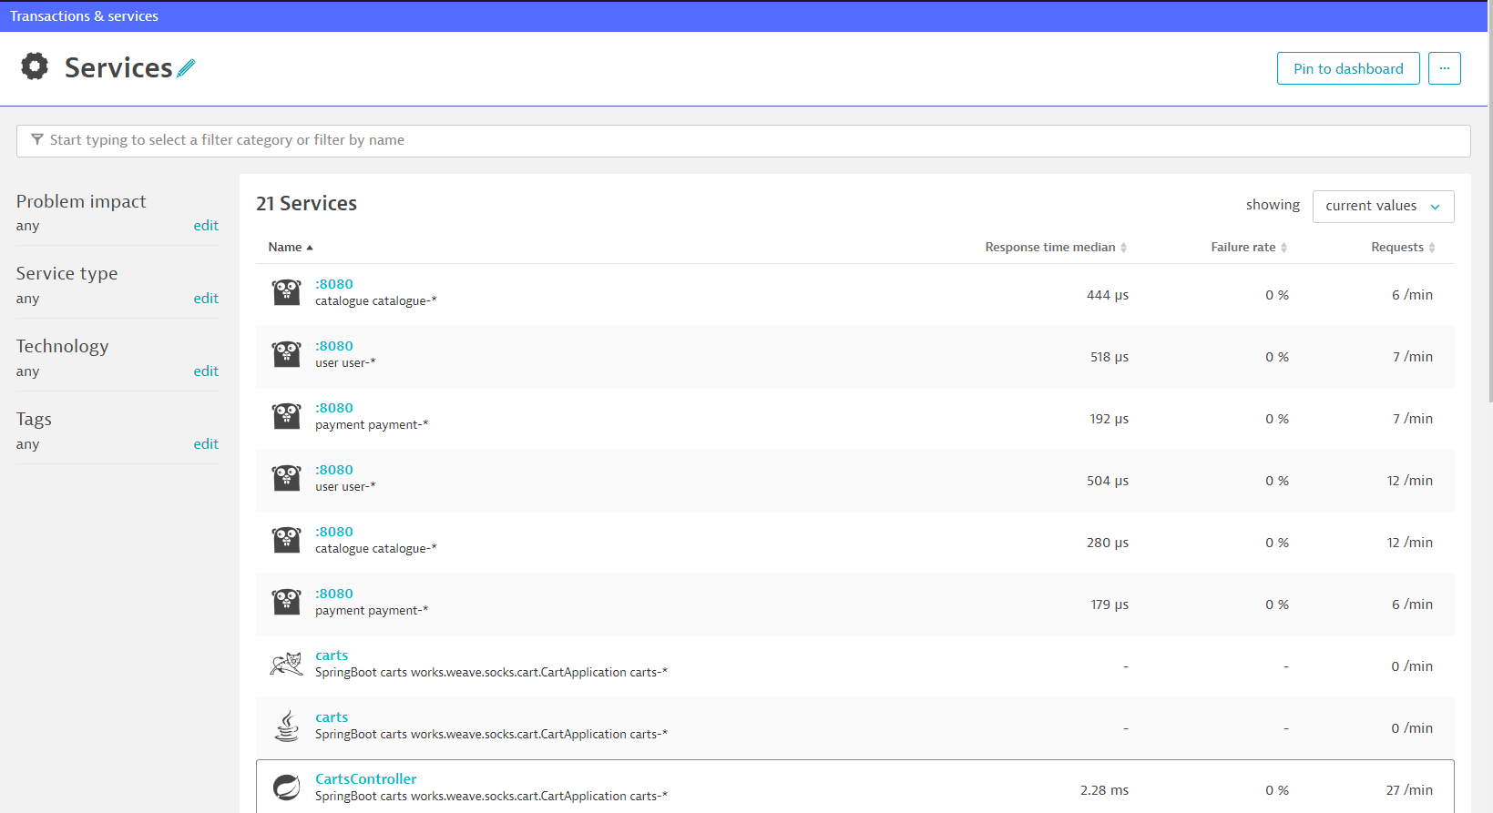
验证 Dynatrace
现在我们知道我们的应用已经部署并成功运行, 我们可以验证所有内容都显示在 Dynatrace 中
导航回 Dynatrace, 您应该会看到主机、进程和服务的数据
Notes:
Validate Dynatrace
Now that we know our application is deployed and running successfully, we can validate that everything is being displayed in Dynatrace
Navigate back to Dynatrace and you should see data for Host, Process and Services

Slide 24
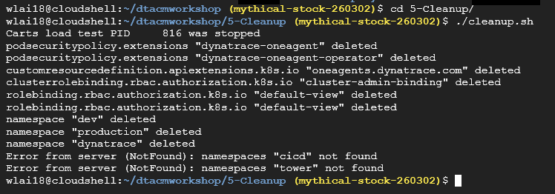
清理脚本占位符
在终端/CloudShell 执行脚本：cleanup.sh
这将删除 dev、prod 和 istio-系统命名空间（及其关联对象）, 所以我们有一个干净的集群
完成后, 我们将在 dev 命名空间中重新部署袜子店应用。 我们只需要执行脚本 util/deploy-sockshop.sh 然后等待几分钟
完成后检查袜子店应用已还原幷运行
kubectl get svc -n dev -o wide
Notes:
Clean up script placeholder
In Terminal/Cloudshell execute the script: cleanup.sh
This will remove the dev, production and istio-system namespaces (and their associated objects) so we have a clean cluster
After this completes, we will redeploy the sock shop application in the dev namespace. We only need to execute the script: deploy-sockshop.sh and then wait a few minutes
Then check if the SockShop app is back up and running
$kubectl get svc –n dev -o wide

Slide 25
部署 Jenkins
Notes:
Deploying Jenkins

Slide 26
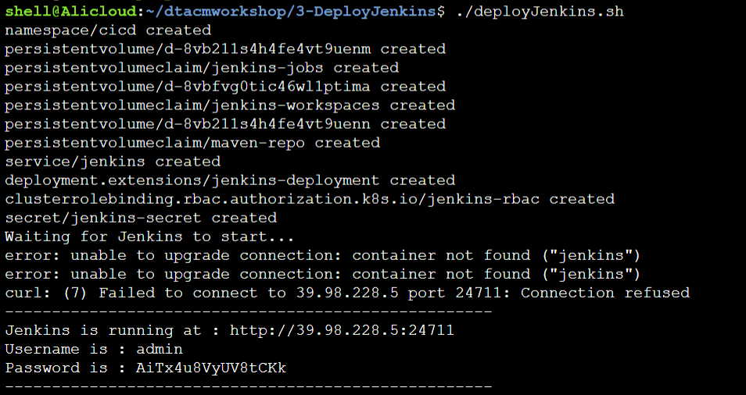
部署Jenkins
在终端/CloudShell 中执行脚本： 3-DeployJenkins 目录中 deployJenkins.sh
这将部署和启动 Jenkins, 导入我们的管道并输出凭据
注意：您应该更改默认密码！
Notes:
Deploy Jenkins
In Terminal/Cloudshell execute the script: deployJenkins.sh in the directory 3-DeployJenkins
This will deploy and startup Jenkins, import our pipeline and output the credentials
需要手动创建pvc，方式和sockshop一样，需要3个pv
修改后，jenkins的pod需要pull image，时间比较长
Note: You should change the default password!

Slide 27
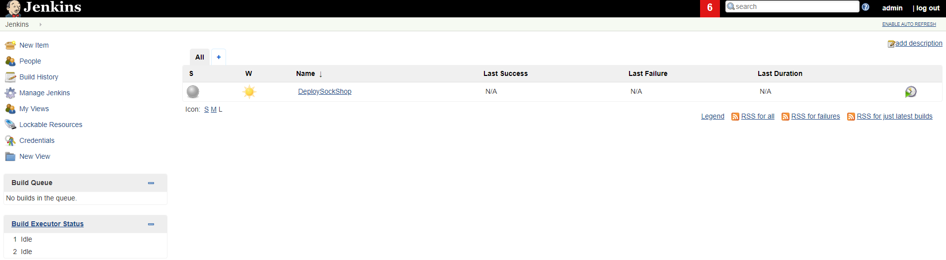
Jenkins 设置
Jenkins 成功部署后, 导航到 Jenkins URL 并使用以前提供的用户名和密码登录（同样, 建议您更改密码）
Notes:
Jenkins Setup
After Jenkins has successfully deployed, navigate to the Jenkins URL and login with the previously provided username and password (again, recommend you change the password ☺

Slide 28
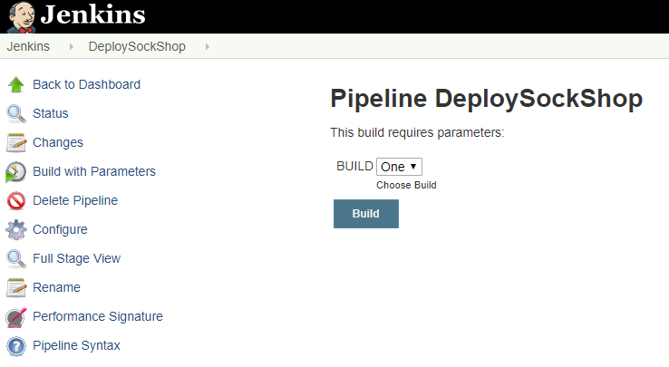
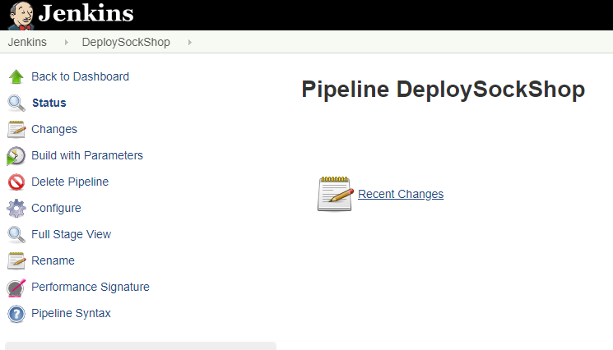
运行我们的第一个管道
在 Jenkins 主屏幕上, 我们应该看到 “DeploySockShop“ 管道, 通过单击管道选择管道
单击使用参数生成
选择“ONE"和生成
Notes:
Run our first pipeline
On the Jenkins main screen we should see the “DeploySockShop” pipeline, select the pipeline by clicking it

Slide 29
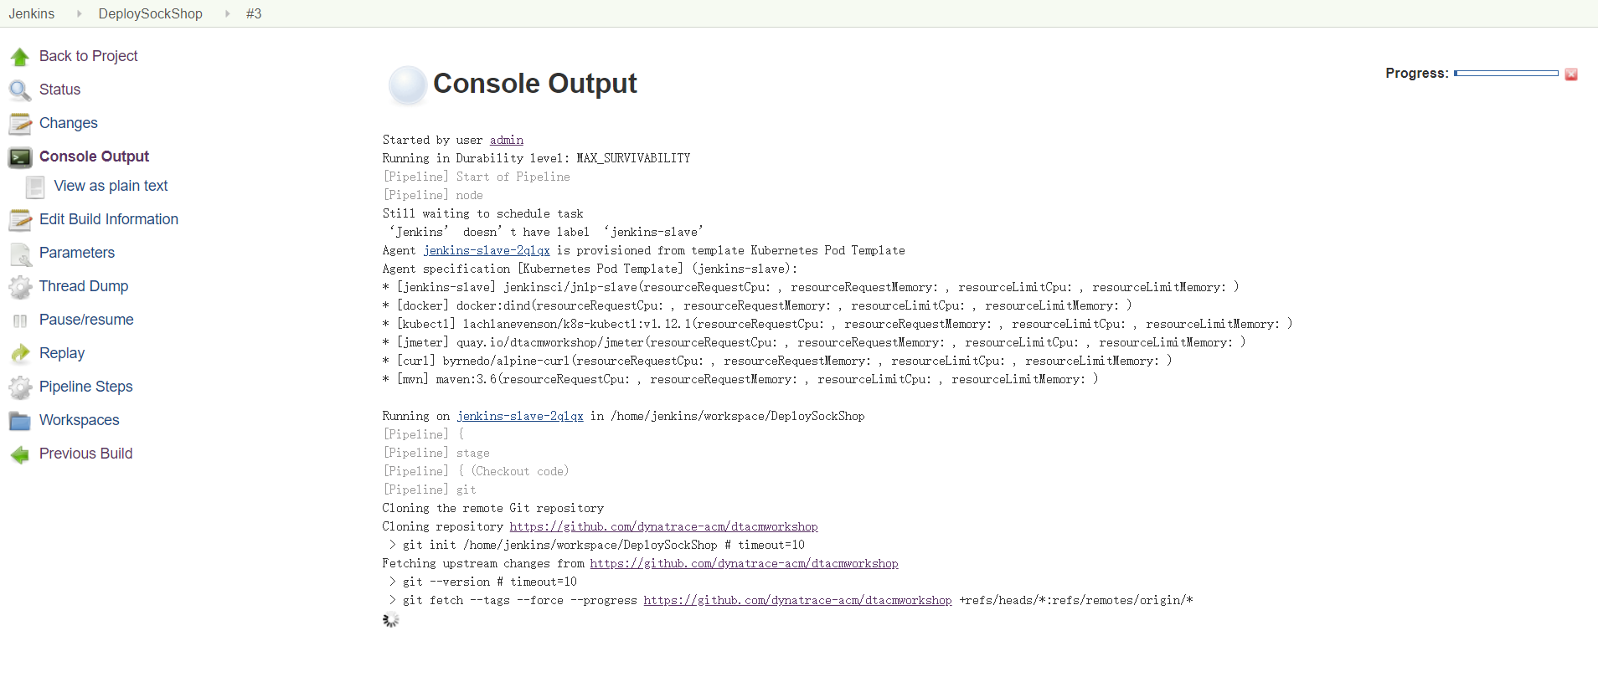
如果一切顺利
Notes:
在console output中如果一直提示Jenkins doesn’t have label jenkins-slave，可以重新运行一下deploy-jenkis.sh（注意注释掉kubectl creater的部分内容）

Slide 30
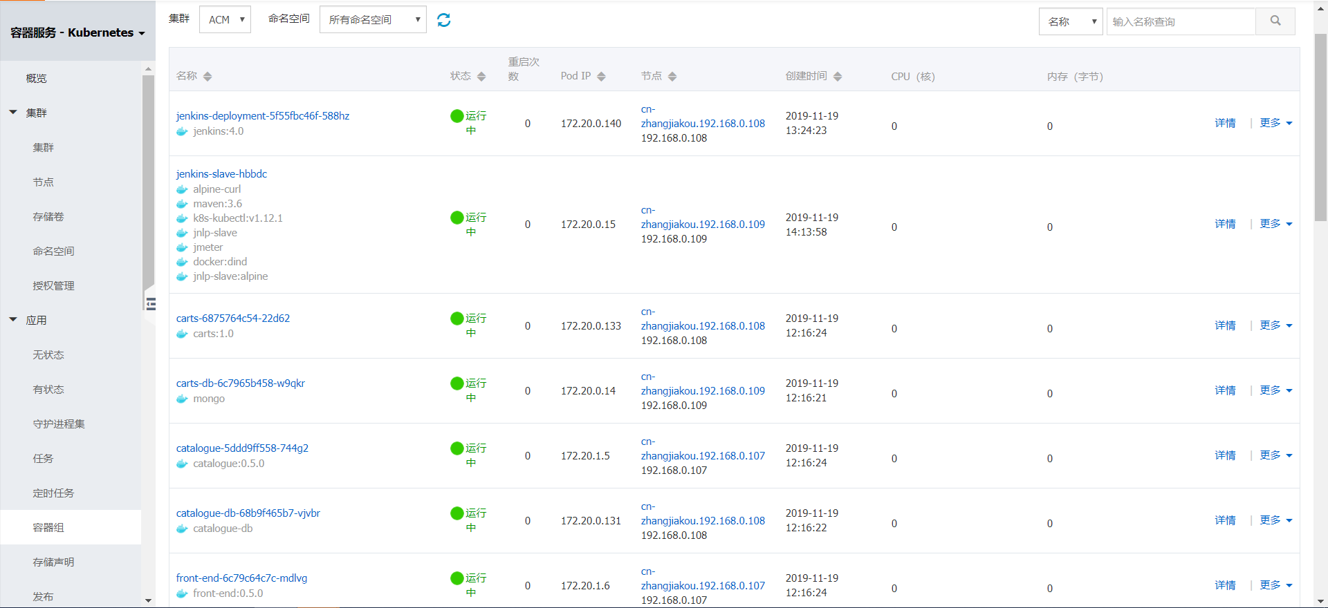
验证jenkins部署状态
Notes:
Build时候，能看到有jenkins-slave pod出现

Slide 31
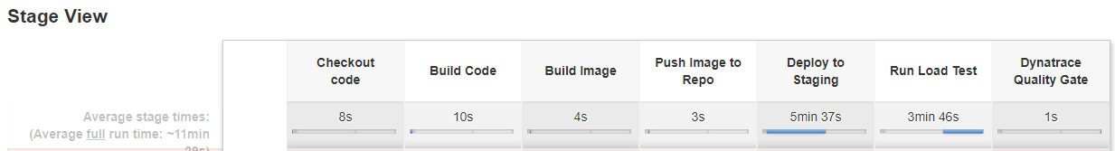
如果一切顺利...
管道应成功运行（注意：这将需要大约 10 分钟）
Notes:
If all goes well…
The pipeline should run successfully (Note: this will take about 10 min)

Slide 32
Dynatrace 整合
Notes:
Dynatrace Integration

Slide 33
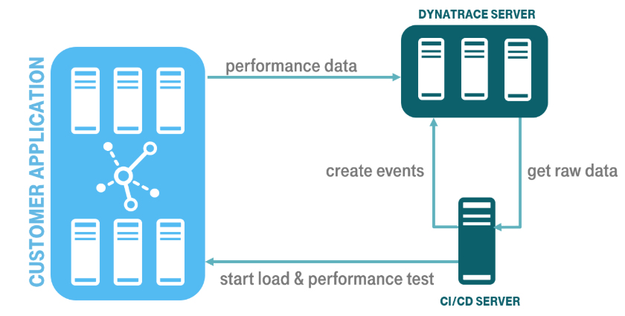
Dynatrace 整合
GitHub 存储库和示例：https://github.com/jenkinsci/performance-signature-dynatrace-plugin/blob/master/README.md
通过 Dynatrace API 集成（时间序列和事件）
基于版本的性能签名 （monospec）
Notes:
Dynatrace Integration
GitHub Repo and Example: https://github.com/jenkinsci/performance-signature-dynatrace-plugin/blob/master/README.md
Integration via the Dynatrace APIs (Timeseries and Events)
Based on a Performance Signature of a release (monspec)

Slide 34
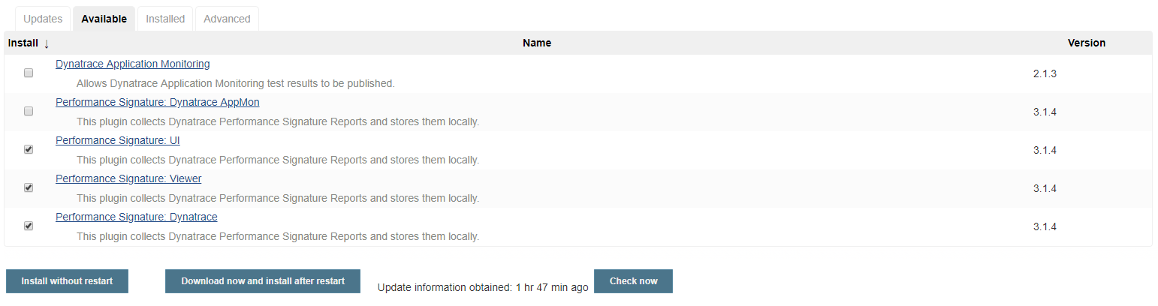
安装 Jenkins 插件
导航到 Manage Jenkins → Manage Plugins 页面并切换到 “Avaliable“ 选项卡。搜索 "Dynatrace“ 关键字, 选择下面的 3 个选项, 然后单击 “Install without restart"
Notes:
Install Jenkins Plugin
Navigate to Manage Jenkins -> Manage Plugins page and switch to the Available tab. Search for the "Dynatrace" keyword, select the 3 options below and click “Install without restart”.

Slide 35
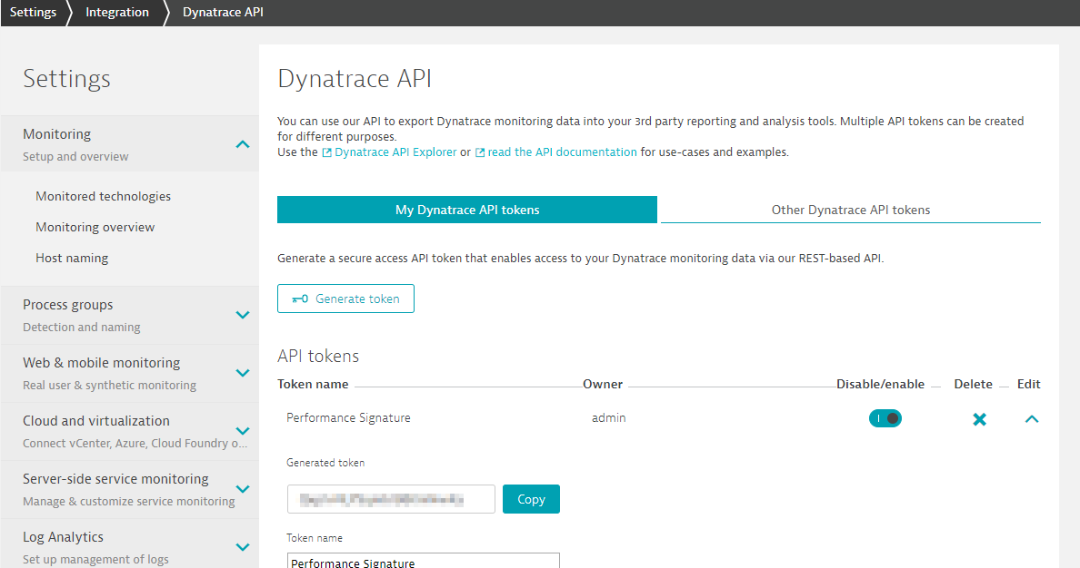
Dynatrace API
集成需要 Dynatrace API 令牌（ Settings → Integration → Dynatrace API ）
只需要默认的前 3 个权限（这可以与在前面的步骤中创建的 API 令牌相同）
Notes:
Dynatrace API
A Dynatrace API Token is needed for the Integration (Settings -> Integration -> Dynatrace API)
Only need the default top 3 permissions (This can be the same API Token as created in earlier steps)

Slide 36
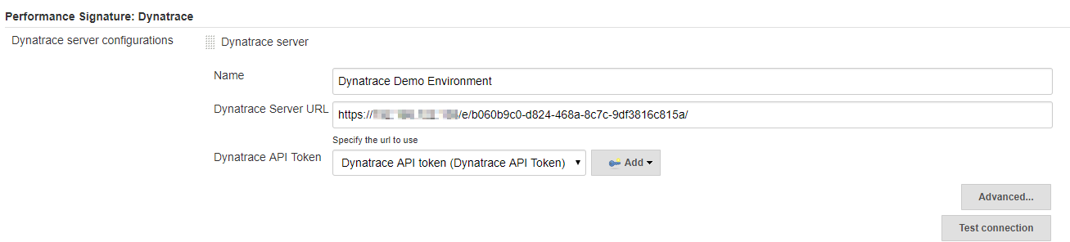
Jenkins 配置
导航到 Manage Jenkins → Configure System → Performance Signature: Dynatrace SaaS/Managed
输入
服务器名稱（例如 Dynatrace Demo 服务器）
您的租户 URL （https://xxxxxxxx.live.dynatrace.com） - SaaS, （https://asdfa.Dynatrace-managed.com/e/asdfafa） - 托管
API 令牌
注意：由于 Jenkins 中的一个错误, 您许多人需要保存并退出此屏幕, 然后返回"添加"下拉列表以工作
测试连接并保存
Notes:
Jenkins Configuration
Navigate to Manage Jenkins -> Configure System -> Performance Signature: Dynatrace SaaS/Managed
Enter name of the
Server (ex. Dynatrace Server)
Your Tenant URL (https://xxxxxxxx.live.dynatrace.com) – SaaS, (https://asdfa.Dynatrace-managed.com/e/asdfafa) - Managed
API Token
Note: You many need to Save and exit this screen and come back for the “Add” dropdown to works, thanks to a bug in Jenkins
Test the Connection and Save

Slide 37
将事件添加到管道
我们将向部署管道中添加三个主要事件：
createDynatraceDeploymentEvent - 将部署事件发送到 Dynatrace
recordDynatraceSession - 设置 Perf 测试存在时的开始和结束时间
perfSigDynatraceReports - 在 perf 测试时间范围内查询所有指标, 并针对规范文件进行比较。 如果指标违反规范文件, 则管道阶段失败
Notes:
Adding Events to our Pipeline
There are three main events we will be adding to our Deployment Pipeline:
createDynatraceDeploymentEvent – Sends the Deployment Event to Dynatrace
recordDynatrace Session – Sets start/end time for when Perf Test beings
perfSigDynatraceReports – Queries all the metrics during the perf test timeframe and compares against the spec file. If metrics violate the spec file, the pipeline stage is failed

Slide 38
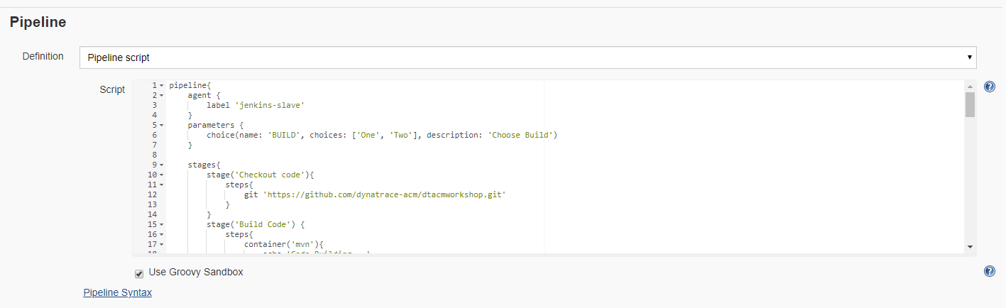
将事件添加到管道
在 DepolySockShop 管道, 单击 “Configure“ 并向下滚动到管道脚本
Notes:
Adding Events to our Pipeline
In the DeploySockShop pipeline, click “Configure” and scroll down to the Pipeline script

Slide 39
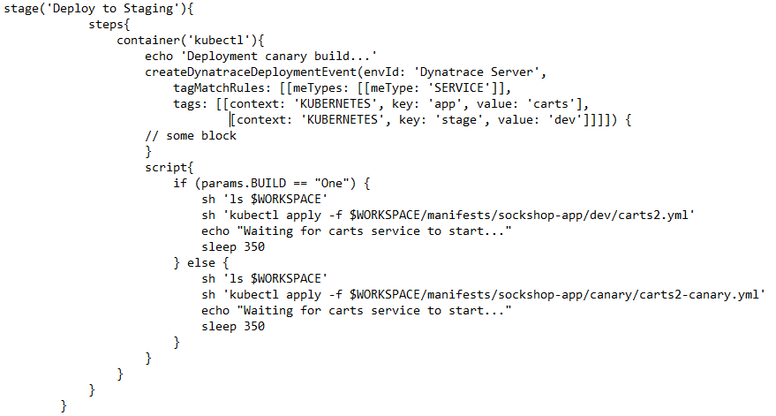
将事件添加到管道和部署事件
首先, 我们希望将部署事件添加到管道中, 以便每次将生成部署到过渡阶段时, Dynatrace 都会了解它
Notes:
Adding Events to our Pipeline – Deployment Events
First we want to add a Deployment Event to our Pipeline so every time we deploy our build to staging, Dynatrace will know about it

Slide 40
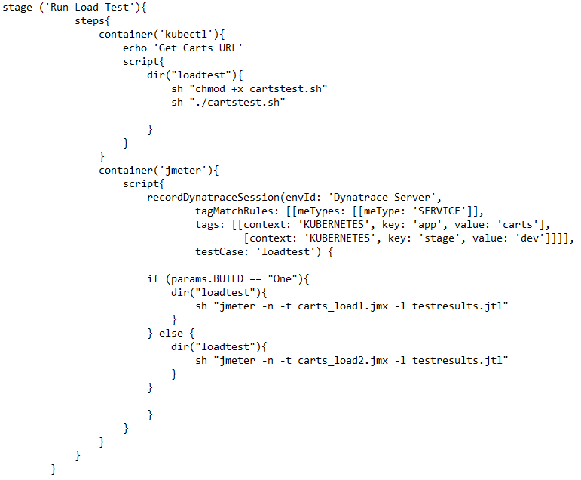
将事件添加到我们的管道 + 记录 Perf 测试
接下来, 我们用recordDynatraceSession 功能包装我们的负载测试阶段, 所以我们知道当测试开始和停止
Notes:
Adding Events to our Pipeline – Record Perf Test
Next we want to wrap our Loadtest stage with the recordDynatraceSession function, so we know when tests start and stop

Slide 41
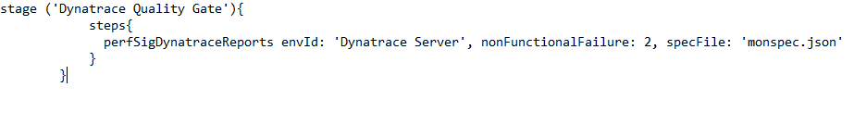
将事件添加到管道 = 将结果在 Monospec 比较
负载测试完成后, 我们希望根据 Monospec 文件（请参阅下一张幻灯片）, 以确定我们的生成是否符合质量
将以下阶段（"Dynatrace 质量门"）添加到我们的管道的末端
Notes:
Adding Events to our Pipeline – Compare results to monspec
After the load test is completed, we want to validate the test against our monspec file (see next slide), to determine if our build meets quality or not
Add the below stage (“Dynatrace Quality Gate”) to the very end of our pipeline

Slide 42
Monspec 範例文件
{
"spec_version": "2.0",
"timeseries": [
{
"timeseriesId": "com.dynatrace.builtin:service.responsetime",
"aggregation": "avg",
"tags": “[Kubernetes]app:carts, [Kubernetes]stage:dev",
"upperWarning": 1000,
"upperSevere": 3000
}
]
}
Notes:
Sample Monspec File
{
"spec_version": "2.0",
"timeseries": [{
"timeseriesId": "com.dynatrace.builtin:service.responsetime",
"aggregation": "avg",
"tags": “[Kubernetes]app:carts, [Kubernetes]stage:dev",
"upperWarning": 1000,
"upperSevere": 3000
}
]
}

Slide 43
将事件添加到管道
将事件添加到管道后, 我们可以应用并保存
注意： 在名为"PipelineWithIntegration.txt”的存储库根目录中已添加事件的示例管道
编辑管道时, 可以使用它作为参考
注意：您需要确保将 Dynatrace 环境的名称更改为与之前命名连接的名称相同。 此文件使用名称 "Dynatrace 服务器“ 作为 Dynatrace 环境名称
Notes:
Adding Events to our Pipeline
Once the events are added to our Pipeline we can apply and save
Note: There is a sample Pipeline with the events already added in the root of the repository titled “PipelineWithIntegration.txt”
You can use this as a reference when editing your pipeline
Note: You will need to make sure you change the name of the Dynatrace Environment to the same thing as you named your connection earlier. This file uses the name “Dynatrace Server” as the Dynatrace Environment Name.

Slide 44
让我们测试一下我们的集成
Notes:
Let’s test our Integration

Slide 45
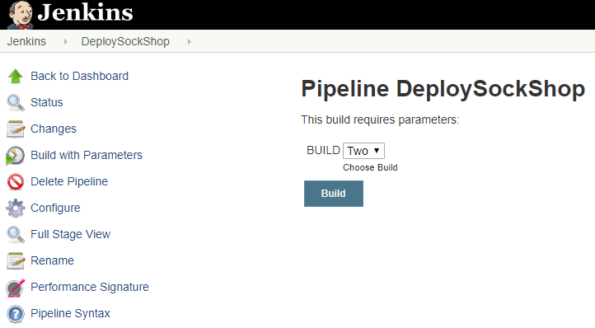
部署生成二
更新并保存管道以包括 Dynatrace 性能事件后, 让我们使用 build 2 重新运行管道
选择 “Two“ 並按 Build
Notes:
Deploy Build Two
After updating and saving our Pipeline to include the Dynatrace Performance Events, let’s re-run our pipeline with build Two

Slide 46
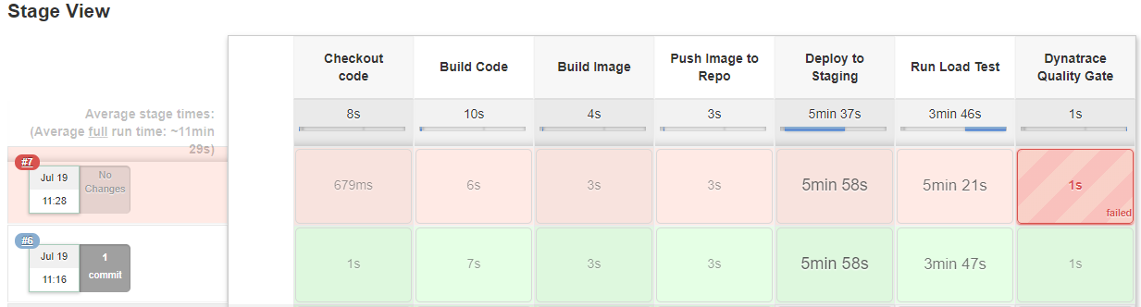
现在, 我们的 build 应该失败
Notes:
Now our build should fail

Slide 47
部署 Ansible Tower
如果我们使用"构建#1重新部署, 此版本应通过我们的 Dynatrace 质量门
选择 “One“ 並按 Build
Notes:
Deploy Ansible Tower
If we redeploy using Build #1, this build should pass our Dynatrace Quality Gate

Slide 48
使用 Ansible Tower 进行自动修复
Notes:
Auto-remediation with Ansible Tower

Slide 49
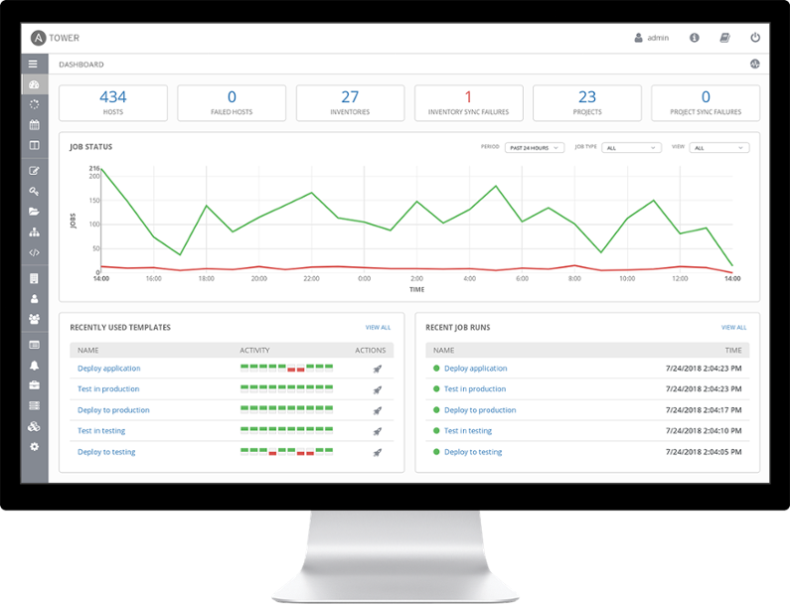
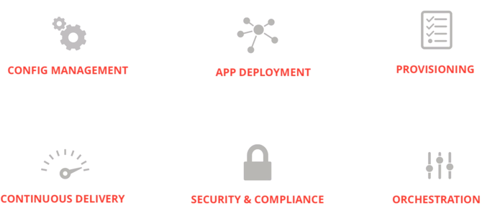

Ansible 与 Ansible Tower
Runbook = 定义：系统操作员（管理员）执行的例行过程和操作的汇编
Ansible
简单自动化语言 + 自动化引擎
人类可读性（yaml）
Ansible Tower
Web UI
运行手册的管理
强大的自动化 API
Notes:
Ansible and Ansible Tower
Runbook – definition: a compilation of routine procedures and operations that the system operator (administrator) carries out
Ansible
Simple automation language + automation engine
Human readable (yaml)
Ansible Tower
Web UI
Management of runbooks
Powerful API for automation
---------------------
In a computer system or network, a runbook is a compilation of routine procedures and operations that the system administrator or operator carries out.
Ansible is an open source IT configuration management, deployment, and orchestration tool. Ansible uses YAML syntax for Ansible playbooks. YAML is used because it is very easy for humans to understand, read and write.
Ansible Tower is the web UI and dashboard for Ansible. It automates and presents tasks graphically, especially the monitoring and dashboard types of tasks.

Slide 50

促销活动
我们将为我们的袜子进行促销活动
此促销将随机提供给客户
购物车服务有一个端点, 使我们能够提供受益于促销礼品的用户百分比
问题是促销实施有缺陷
没有人知道, 这可能会对品牌和商业声誉产生灾难性的影响
Notes:
Promotional campaign
We’ll be implementing a promotional campaign for our socks
This promotion will be randomly available to customers
The carts service has an endpoint allowing us to provide the percentage of users that will benefit from the promotional gift
The problem is that the promotion implementation is defective ☹
Nobody knows about it yet and this could potentially have disastrous effect on the brand and business reputation
---------------------
We’ll be implementing this use case with the carts service, since this feature is already implemented. The carts service includes the endpoint carts/1/items/promotional/ that can take a numeric input value, the percentages of user interactions that will receive the promotional gift. For example, say 5% of users.
Therefore, we can easily change the behavior of our carts service at runtime. However, changing the value without using a configuration management system would not allow us to track when changes happened and which configuration values have changed. So, that’s why we are using Ansible Tower to execute changes in our configuration.

Slide 51




Runbook 自动化工作流
T操纵者促销活动
设置促销费率自50 %
设置促销价格自50 %
发送自定义配置事件
监视器袜子跳 + 检测
故障率增加
发送问题通知
将促销率设置为 0 %
发送自定义配置事件
将注释发送到问题
Notes:
Runbook automation workflow
---------------------
We’ll be implementing this use case with the carts service, since this feature is already implemented. The carts service includes the endpoint carts/1/items/promotional/ that can take a numeric input value, the percentages of user interactions that will receive the promotional gift. For example, say 50% of users.
Therefore, we can easily change the behavior of our carts service at runtime. However, changing the value without using a configuration management system would not allow us to track when changes happened and which configuration values have changed. So, that’s why we are using Ansible Tower to execute changes in our configuration.

Slide 52
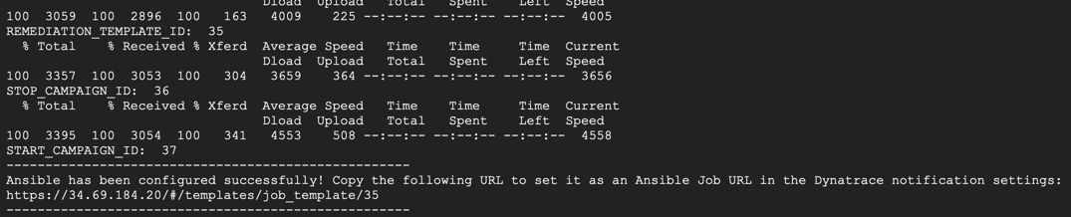
部署Ansible Tower
在终端/CloudShell 中执行 4-DeployTower 目录中脚本 deployTower.sh
这将部署和启动 Ansible Tower。这还将配置 Ansible Tower、导入项目、清单、凭据（DT API 令牌）和 playbook 模板
记下脚本显示的 Ansible Tower 作业 URL。下一步你会需要它
Notes:
Deploy Ansible Tower
In Terminal/Cloudshell execute the script: deployTower.sh in the directory 4-DeployTower
This will deploy and startup Ansible Tower. This will also configure Tower, import projects, inventories, credentials (DT API token) and playbook templates.
Take a note of the Ansible Job URL displayed by the script. You will need it for a next step.

Slide 53
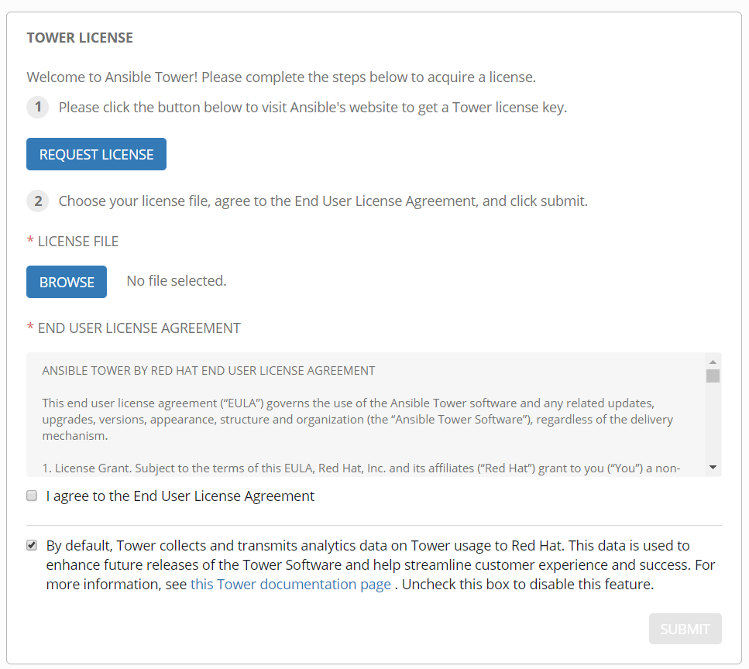
登录 Ansible Tower 控制台
使用之前复制的作业模板 URL（没有路径）并将其复制到浏览器中以加载 Ansble Tower 控制台
例如, 如果作业模板 URL 为 ：https://34.69.184.20/#/templates/job_template/35
然后控制台 URL 为 ：https://34.69.184.20
系统将提示您提供许可证文件并接受许可协议
如果您还没有许可证文件, 请单击按钮从红帽申请免费试用许可证（通过电子邮件发送）
登录 Ansible Tower
用户名 ： admin
密码：Dynatrace
Notes:
Log in the Ansible Tower console
Use the job template URL you copied earlier, without the path, and copy it in your browser to load the Ansible Tower console
For example, if the job template URL was : https://34.69.184.20/#/templates/job_template/35
then the console URL is : https://34.69.184.20
You will be prompted to provide a license file and accept the license agreement
If you don’t already have your license file, click the button to request a free trial license from Red Hat (delivered via email)
Log in Ansible Tower
username : admin
password : dynatrace

Slide 54
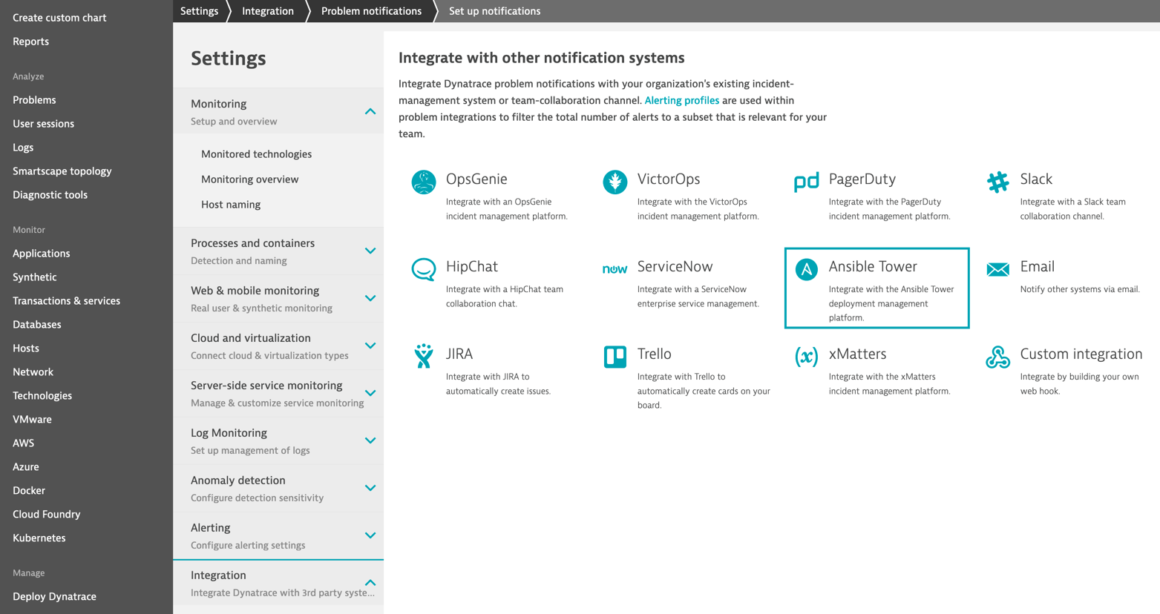
配置 Dynatrace 问题通知
在 Dynatrace UI 中, 导航到 Settings → Integration → Problem notification → Ansible Tower
Notes:
Configure Dynatrace Problem Notification
In the Dynatrace UI, navigate to Settings -> Integration -> Problem Notification -> Ansible Tower

Slide 55
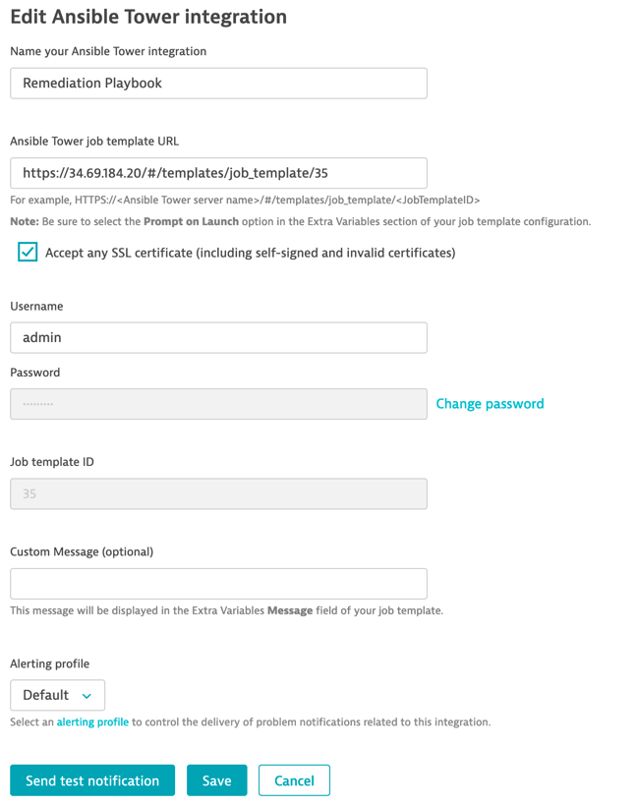

配置 Ansible Tower 集成
输入部署后提供的 Ansible Tower 作业模板 URL
输入要访问 Ansible 的凭据
用户名 ： admin
密码 ： Dynatrace
单击 “Send test notification“ 按钮以验证配置
成功后, 将显示绿色确认消息
保存配置
Notes:
Configure Ansible Tower integration
Enter the Ansible Tower job template URL you were provided after the deployment
Enter the credentials to access Ansible
username : admin
password : Dynatrace
Click the Sent test notification button to validate your configuration
on success, a green confirmation message will be displayed
Save your configuration

Slide 56
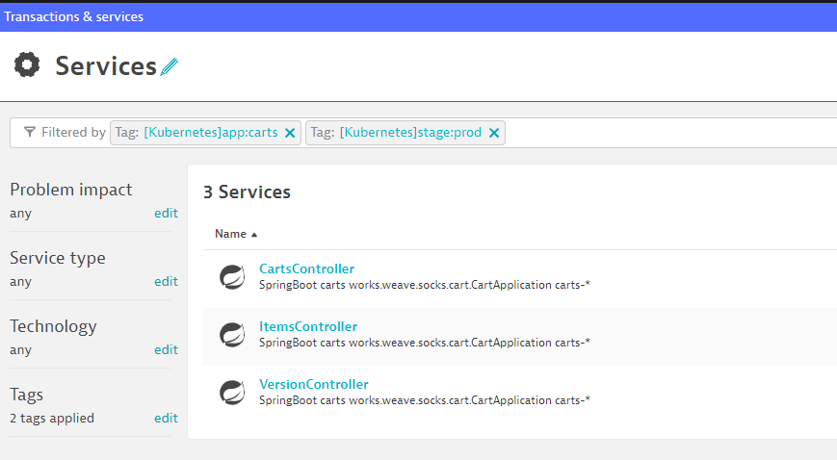
调整异常检测
Dynatrace 中的问题和异常检测都利用了 AI 技术。这意味着 AI 可以了解每个微服务如何执行这些微服务并对其进行基线。因此, 在演示场景中, 例如我们现在, 我们必须使用用户定义的值覆盖 AI 引擎, 以便由于人为增加故障率而产生问题。(请注意：如果我们让应用运行并模拟最终用户流量几个小时/天, 则无需执行此步骤）
在 Dynatrace 租户中, 导航到"交易与服务", 然后按：[Kubernetes]app:carts and [Kubernetes]environment:production
Notes:
Adjust Anomaly Detection
Both problem and anomaly detection in Dynatrace leverage AI technology. This means that the AI learns how each and every microservice behaves and baselines them. Therefore, in a demo scenario like we have right now, we have to override the AI engine with user-defined values to allow the creation of problems due to an artificial increase of a failure rate. (Please note: if we would have the application running and simulate end-user traffic for a couple of hours/days there would be no need for this step.)
In your Dynatrace tenant, navigate to “Transaction & services” and filter by: [Kubernetes]app:carts and [Kubernetes]environment:production

Slide 57
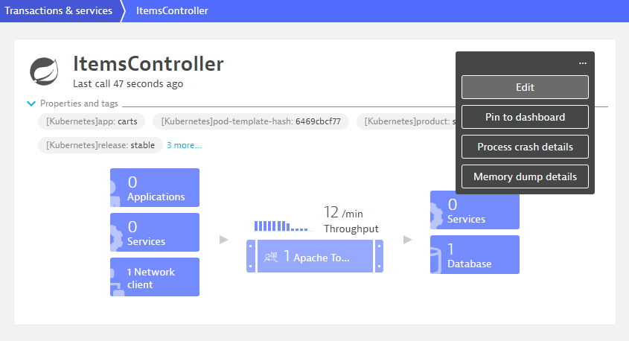
调整异常检测（连续）
单击 ItemsController 然后在服务名称旁边的三个点 （ ... ） 上, 点击 Edit
Notes:
Adjust Anomaly Detection (Cont.)
Click on the ItemsController and then on the three dots ( … ) next to the service name. Click on Edit

Slide 58
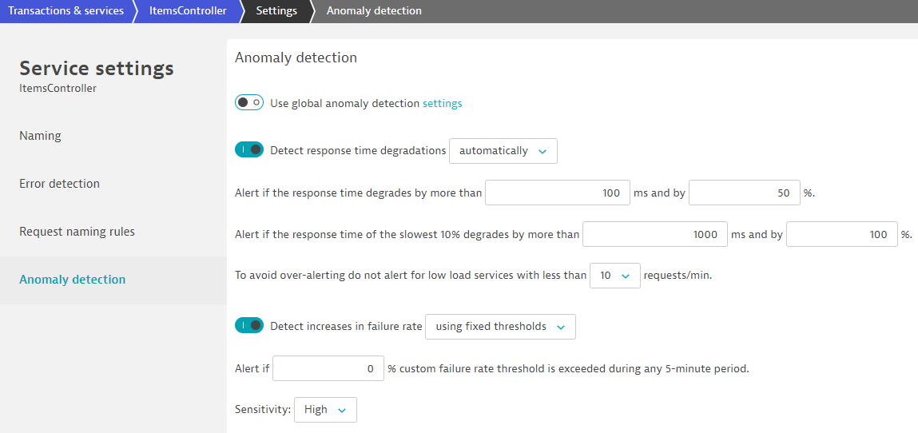
调整异常检测（续）
在下一个屏幕, 编辑以下屏幕截图中所示的异常检测设置
Notes:
Adjust Anomaly Detection (Cont.)
On the next screen, edit the anomaly detection settings as seen in the following screenshot. - Global anomaly detection has to be turned off - Detect increases in failure rate using fixed thresholds - Alert if 0 % custom failure rate threshold is exceed during any 5-minute period. - Sensitivity: High

Slide 59
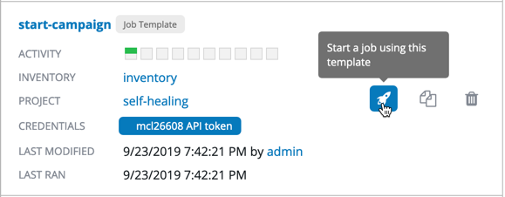
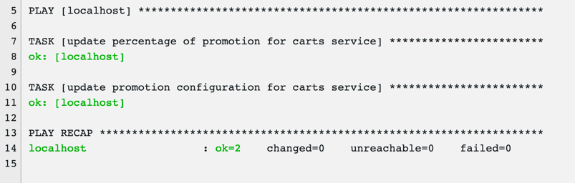
启动活动 playbook
导航回 Ansible Tower UI
从侧菜单中, 导航到 Resource → Templates
点击”火箭”图标启动 start-campaign playbook
在提示弹出窗口上点击“Next", 然后启动
当 playbook运行时, 将显示输出。验证回顾是否显示 OK=2
Notes:
Launch Campaign playbook
Navigate back to the Ansible Tower UI
From the side menu, navigate to Resources -> Templates
Click on the rocket icon to launch the start-campaign playbook
Hit Next on the prompt popup window and then Launch
As the playbook runs, the output will be displayed. Validate that the recap shows OK=2

Slide 60
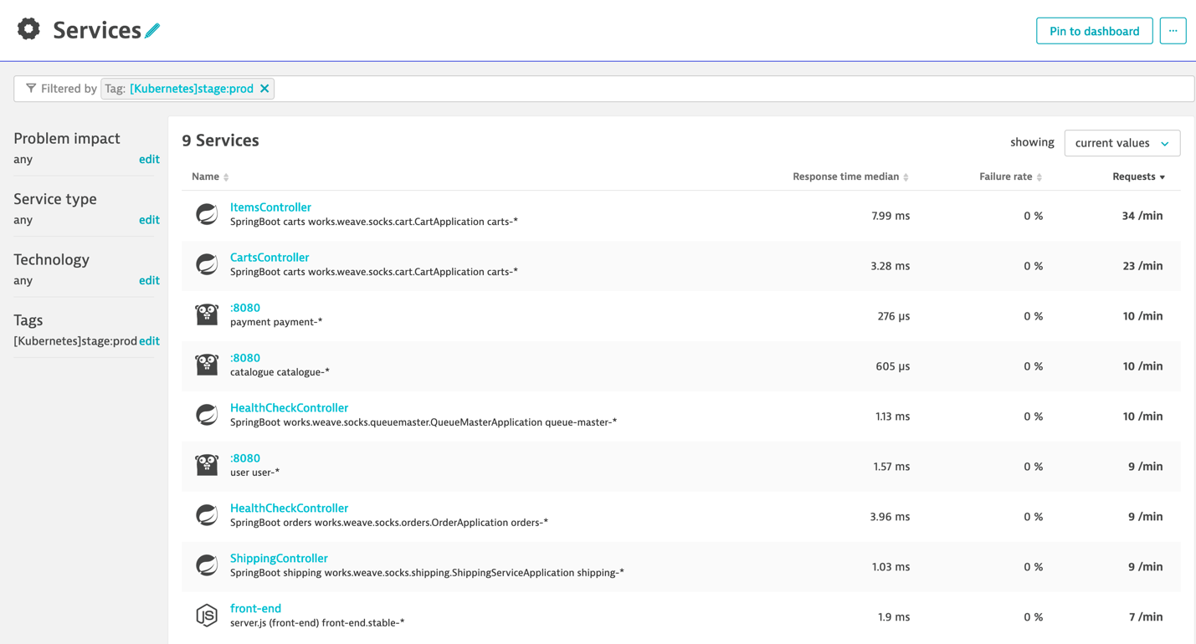
观察促销活动
在 Dynatrace 控制台中, 导航到 “Transaction & Service” 并深入到生产中项目控制器服务
提示 ： 按标签筛选 - [Kubernetes]stage:prod 仅显示生产中的服务
Notes:
Observe the promotional campaign
In the Dynatrace console, navigate to Transactions & Services and drill-down into the production ItemsController service
Tip : filter by tag : [Kubernetes]stage:prod to only display services in production

Slide 61
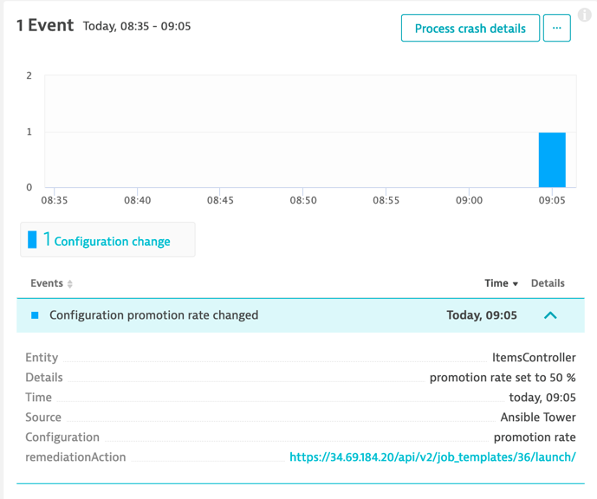
观察促销活动
查看 Service 事件
当促销率变更至 50% 时, “Start Campaign” playbook 已通知 Dynatrace
Notes:
Observe the promotional campaign
Look at the Service events.
The Start Campaign playbook have notified Dynatrace when the promotional rate was changed to 50%

Slide 62
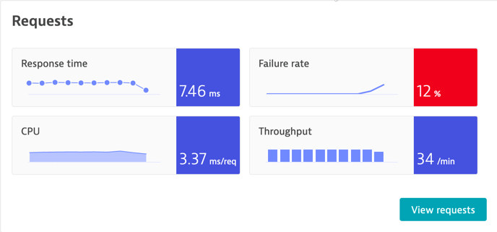
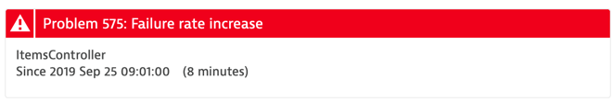
观察促销活动
您应该看到故障率增加, 最终导致 Dynatrace 检测到问题
您可能需要刷新浏览器几次
Notes:
Observe the promotional campaign
You should see the Failure Rate increasing, eventually leading to Dynatrace detecting a Problem
You might need to refresh your browser a few times

Slide 63
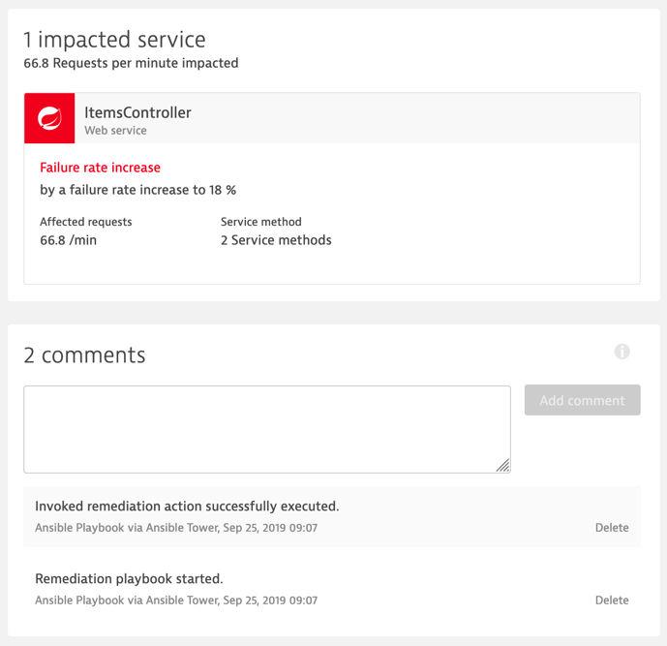
观察自动修复 playbook 操作
返回 Service 视图
注释部分将显示 Ansible Tower 采取的补救措施
Notes:
Observe the auto-remediation playbook actions
Go back to the Service view
The comments section will show the remediation actions taken by Ansible Tower

Slide 64

观察自动修复行动 playbook 操作
在问题中向下钻取
您将看到由 Ansible Tower 报告的新配置更改事件
促销率已设置为 0%, 以修复事务失败
Notes:
Observe the auto-remediation playbook actions
Drill-down in the Problem.
You will see a new configuration change event reported by Ansible Tower
The promotional rate has been set back to 0% to remediate to the transaction failures

Slide 65

观察自动修复行动手册操作
在 Ansible Tower 中执行的作业
启动活动（设定比率为 50%）
修复
将注释推送到 Dynatrace 问题
检索问题详细信息
启动与问题上下文相关的补救操作
更新 Dynatrace 问题
停止活动（设定速率为 0%）
Notes:
Observe the auto-remediation playbook actions
Jobs executed in Ansible Tower
start-campaign (set rate to 50%)
remediation
push comment to Dynatrace Problem
retrieve problem details
launch remediation action related to problem context
update Dynatrace Problem
stop-campaign (set rate to 0%)

Slide 66

就是这样！问题自动解决
查看服务故障率。已返回为 0%
Notes:
That’s it! Problem solved automatically
Look at the Service Failure Rate. It has returned to 0%

Slide 67
Runbook 自动化工作流概述
操纵者促销活动
设置促销费率自50 %
设置促销价格自50 %
发送自定义配置事件
监视器袜子跳 + 检测
故障率增加
发送问题通知
将促销率设置为 0 %
发送自定义配置事件
将注释发送到问题
Notes:
Runbook automation workflow recap

Slide 68
清理
Notes:
Clean up

Slide 69
清理
如果要使集群保持运行, 但：
移除 Jenkins ：执行包含在 utils 目录 removeJenkins.sh 脚本
移除 Ansible Tower ： 执行包含在 utils 目录的 removeTower.sh 脚本
如果要删除所有内容, 请随时通过 GKE 控制台删除 GKE 集群
Notes:
Clean up
If you want to keep the cluster running but:
remove Jenkins : execute the script removeJenkins.sh contained in the utils directory
remove Ansible Tower : execute the script removeTower.sh container in the utils directory
If you want to delete everything, feel free to delete the GKE cluster via the GKE Console

